Slide 1

Online Proctoring System Using AI
VIDHI TANWAR
SANSKRITI RAJPUT

Slide 2
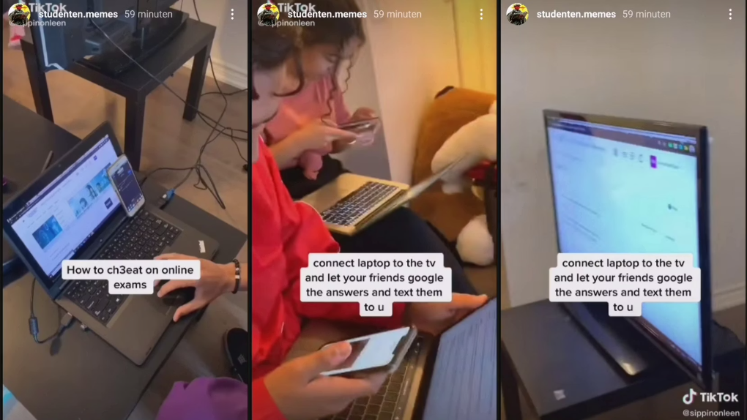
Motivation & Problem Statement
Challenges of Manual Proctoring
Need for Automated Solutions
The rapid growth of online education has increased the use of online examinations.
However, conducting fair and secure online exams is a major challenge.
Traditional online exams lack proper monitoring, which allows students to cheat by:
Looking away from the screen
Using mobile phones or books
Taking help from other people
Manual invigilation is time-consuming and not scalable for large numbers of students.
Therefore, there is a strong need for an automated and intelligent proctoring system.

Slide 3
Existing Systems Vs Proposed System
There are softwares like Mettl, ExamProcto, Pearson VUE, Wheebox etc.
The system is designed to be convenient, affordable, and easy to use from both the examinee’s and examiner’s perspectives since it only requires having one inexpensive camera and a microphone.
They are good softwares which were developed by hundreds of developers and with a very strong productions and data sets.
With the captured videos and audio, we extract features from the following basic components: phone detection, speech detection, text detection, gaze estimation, active window detection, and user verification.
But, none of them are actually used by educational institutes.
Most of the educational institutes use applications like Teams and Google Classroom, which merely cares about the integrity of the examination process.
Small educational institutes such as primary and high schools can easily use it.

Slide 4
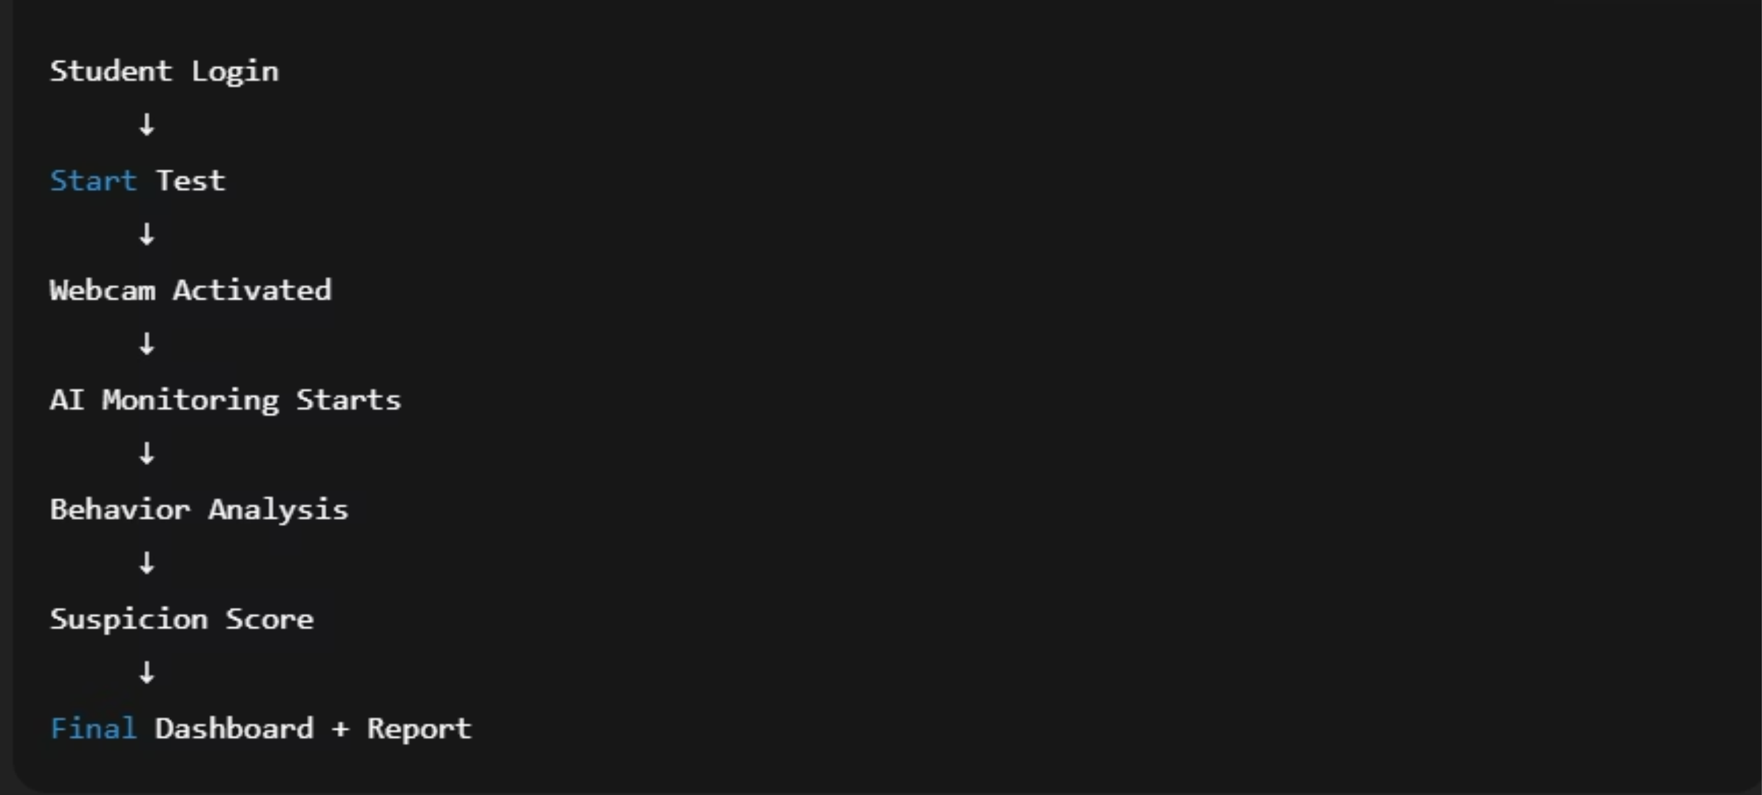
Real-time AI Proctoring

Slide 5

System Architecture
Dashboard + Analysis Viewer
Webcam Input
Live video feed capture
Visualize results and metrics
AI Detection Modules
Report Builder
Modular Detection Pipeline
Compile incident summaries
Object and behavior recognition
Flag Generator
Suspicion Engine
Create actionable alerts
Aggregate anomaly scoring
A modular architecture ensures accuracy, speed, robustness, and easy debugging for the system.

Slide 6
Technologies Used
Python – for backend and AI logic
XAMPP - Database
OpenCV – for webcam access and image processing
MediaPipe – for face, eye, and mouth detection
Flask – to build the web application
HTML, CSS, JavaScript – for frontend
JSON – to store logs and reports

Slide 7
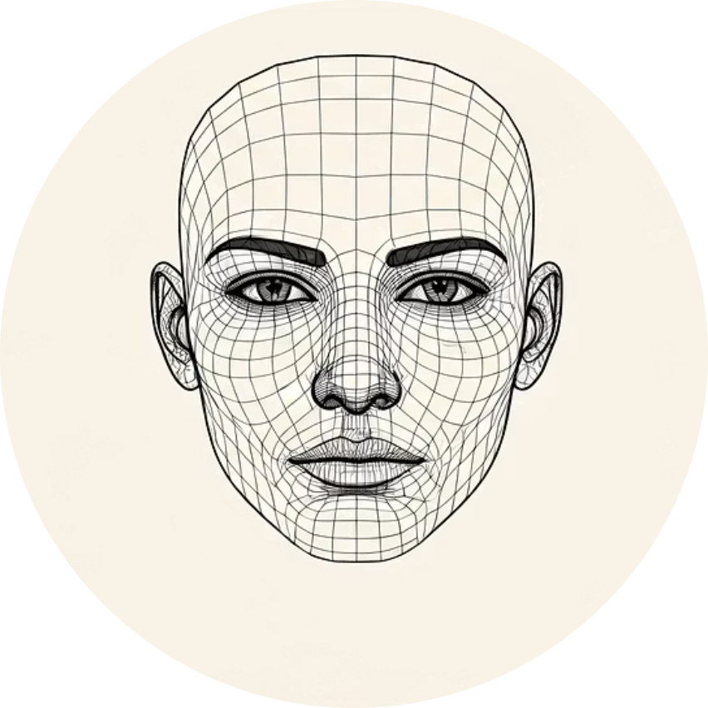





Core AI Modules
Face Detection
Eye Blink Counter
Gaze Direction
Mouth Activity
Head Pose
Heatmap Analysis
These modules run simultaneously to generate suspicion scores.

Slide 8
Dashboard
Displays real-time monitoring results of the student during the exam
Shows detected activities like face presence, eye movement, and talking
Helps the examiner quickly review student behavior and exam integrity
Suspicion Score
Indicates the level of suspicious or cheating behavior detected
Calculated using AI-based behavior analysis and detection modules
Higher score means higher risk of cheating during the exam

Slide 9



Future Work & Enhancements
Audio Cheating
Admin Live Monitoring
Anti-screen Switching
The system is scalable and ready for continuous enhancements.

Slide 10
SDG Goals Align With The Project
1. SDG 4: Quality Education Promotes accessible and fair examinations for students globally. Ensures continuity of education and assessment even during crises (e.g., pandemic).
2. SDG 9: Industry, Innovation, and Infrastructure Uses AI and cloud technologies to create innovative exam monitoring systems. Encourages scalable and secure digital infrastructure for educational institutions.
3. SDG 10: Reduced Inequalities Enables equal opportunity for remote learners from rural and urban areas. Removes geographical barriers to standardized assessments.

Slide 11
Thank You
VIDHI TANWAR
SANSKRITI RAJPUT

